Slide 1
Natural Proportional Breast Augmentation
_{Larry Weinstein MD FACS}
_{Chester, New Jersey, USA}

Slide 2
Proportional Breast Augmentation
Breast Augmentation for body disproportion secondary to
Small chest size
Retruded Chest wall
Breast Hypoplasia * most common indication
Breast Aplasia
Breast Asymmetry

Slide 3
Goddess of Fertility Disproportionately Top Heavy

Slide 4
Implant Selection: Key to Satisfaction
Selection of Implants
Diameter from Anterior Axillary line to Midline
Diameter of Breast
Circumferential diameter of Breast vs. Waist vs. Hips
Tight Sport Bra with select implants or Mentor Gel Sizers
Photographic Documentation and comparison to real results

Slide 5
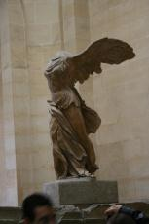
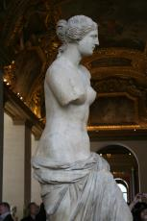
Nike Le Revolution Venus

Slide 6
Petersdorf The Three graces

Slide 7
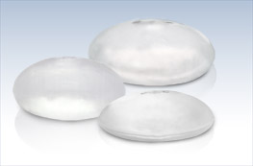
Implant Profile key to proportional outcome
High Profile
Moderate Profile
Low Profile

Slide 8
524 Charts reviewed one private office by medical student
Mean age 33.9 +/- 9.5 years
Range of 15 to 74 years of age
Mean follow up 18.4 +/- 25 months
BMI
Less then 18.4 in 53 or 10.4%
18.5 to 24.9 in 383 or 73%
25 to 30 in 33 or 6%
Over 30 in 6 or 1%

Slide 9
25 year old 5’5” 117lbs. A to B cup with 275cc low profile saline implants measurements 30-23-35 after 34-23-35 9mo

Slide 10
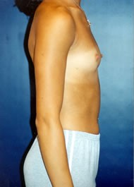
19 year old 5’3” 110lbs 300cc saline moderate plus implants
32Acup 30-24-35
34 B Cup33-24-35 6 mos post

Slide 11
Retruded chest wall of 18 y/o 5’10” 152lb Submuscular high profile 460cc implants
Pre 34A 34-28-40
Post 36C 36-28-40

Slide 12
Postpartum Breast atrophy
fixed with Breast Augmentation

Slide 13
Breast Rejuvenation with
Proportional Breast Augmentation

Slide 14
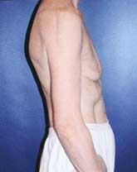
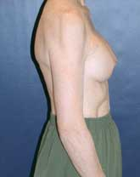
Breast Atrophy Correction
69 year old nudist
Complaint breast atrophy
Low Profile breast implant
Natural Proportional B cups

Slide 15
Breast Augmentation with Cleavage

Slide 16
Complications
Capsular Contracture 12 2.3%
Rupture 17 3.2%
Displacement 17 3.2%
Reoperation to small 4 0.8%
Reoperation to large 2 0.4%
Exposure loss of implant 1 0.2%
Pneumothorax 1 0.2%
Deep Venous Thrombosis 1 0.2%

Slide 17
32 of 524 or 6% of my Breast Augmentations performed thru abdominoplasty . Indications for breast augmentation: postpartum involution of breasts, pseudoptosis and hypomastia.
Indications for abdominoplasty: excess abdominal skin, diastasis rectus, severe striae (stretch marks), excess abdominal adipose tissue, unwanted abdominal tattoos, undefined umbilicus, abdominal hernias and scars.
The low Abdominoplasty incision subpectoral breast dissection can be effected with blunt sounds and endoscopic visualization or with a Spacemaker (balloon, saline implant sizer) dissector.
Results: Average age 38.22 years SD 9.03 (19-60), average BMI 24.04 SD 4.42 (17-37), av. breast implant size 386.08cc SD 92.07 (175-600) and average follow up 18.84 months SD 16.73 (1-60).
Proportionality = [(bust-waist) / (hip-waist)].
Pre-proportionality: .63 for ABA Post-proportionality: .99 for ABA.
No significant difference in complications between the ABA vs. others.

Slide 18
Mommy Makeover “aba” for 33 year old abdominoplasty breast augmentation
Pre 36-35-40
Post 39-31-39 11mos.

Slide 19
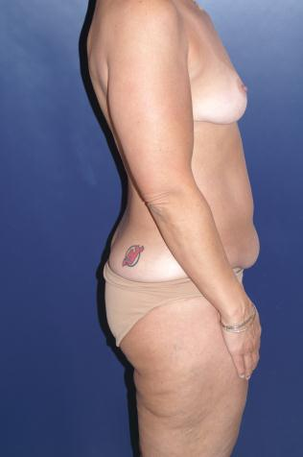
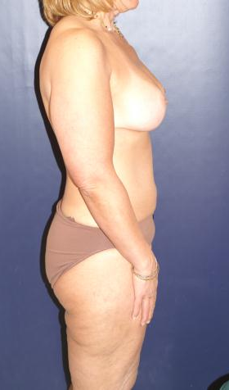
47 y/o psuedoptotic breasts, excess abdominal skin, fat of abdomen and hips.. high profile 420cc implants through abdominoplasty hip liposuction.
Pre 36-35-40
Post 39-30-39 3 mos.

Slide 20
Mommy Makeover for 37 Y/o multiparous Breast Implants Thru Abdominoplasty Liposculpture of thighs & buttocks
Pre 35-32-40
Post 36-26-36 12 mos.

